Slide 1

Output device simulation results CHEN Xuanyan Supervisor: GAN Zecheng

Slide 2
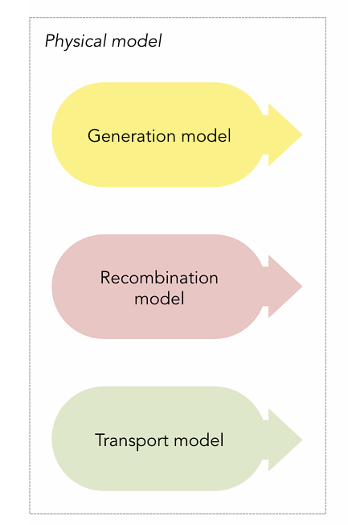

Output physical outcome
r = dfana.calcr(sol, mesh_option)

Slide 3
Current density | flux density | Recombination
Jn: electron density vs. x (row) electron density vs. t (column) | Jndrift: electron drift flux density Jndiffu: electron diffusion flux density | btb: Band-to-band recombination
Jp: hole density vs. x (row) hole density vs. t (column) | Jpdrift: hole drift flux density Jpdiffu: hole diffusion flux density | srh: Shockley-Read-Hall recombination
Jc: cation density vs. x (row) cation density vs. t (column) | Jcdrift: cation drift flux density Jcdiffu: cation diffusion flux density | vsr: Surface recombination at interfaces
Ja: anion density vs. x (row) anion density vs. t (column) | Jadrift: anion drift flux density Jadiffu: anion diffusion flux density | tot: = btb + srh + vsr
Jdisp: displacement current | Jddisp: flux displacement current
Jtot: = Jn + Jp + Jc + Ja + Jdisp | Jddtot: = Jndrift + Jndiffu + Jpdrift + Jpdiffu + Jcdrift + Jcdiffu + Jadrift + Jadiffu + Jddisp
Potential & Energy | Electrostatic potential & Electric field
EFn: electron quasi-Fermi levels | Vion: Electrostatic potential due to ionic charge and anion and cation densities
EFp: hole quasi-Fermi levels | Fion: Electric field due to the ionic charge
Ecb: conduction band | rho: Volumetric charge density
Evb: valence band

Slide 4
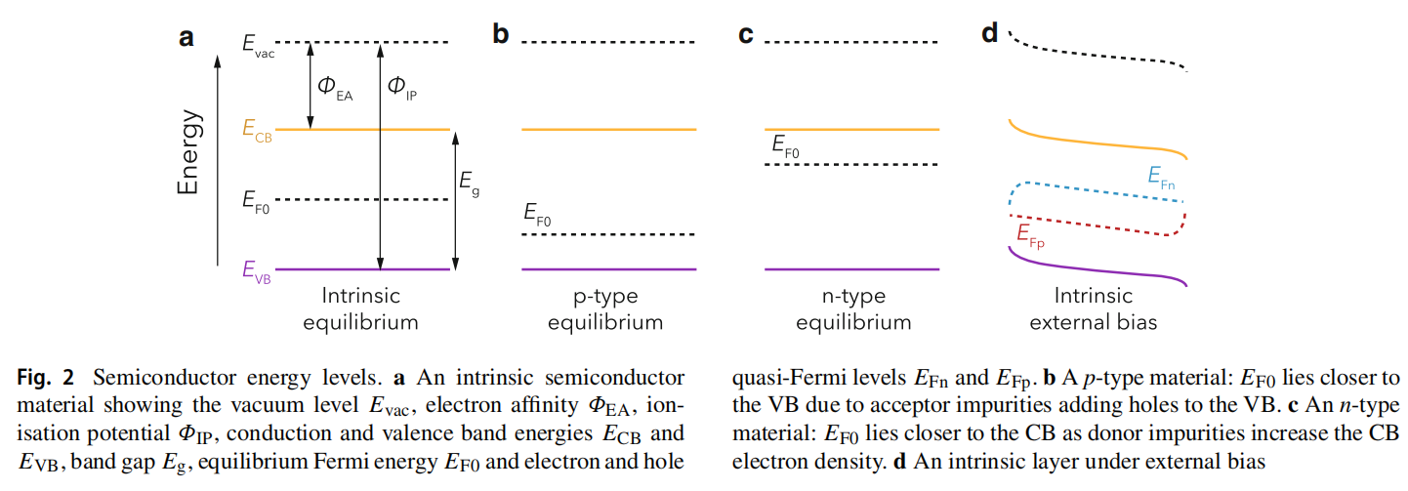
E_{Fn} & E_{Fp}
J Comput Electron21, 960–991 (2022)

Slide 5
dfplot
Currents | Charge & Fields | Carriers & Recombination
JT: Current vs. t | RHOX: Charge density vs. x | NPX: n/p density vs. x
JX: Total current vs. x | ΔRHOX: ΔCharge density | ACX: Anion/Cation vs. x
JV: J-V curve (legacy) | SIGMAT: σ(t) integrated | RX: Recombination rates vs. x
JTOTVAPP: Jtot vs. Vapp | QT: Q(t) in [X1,X2] | JRECVAPP: Recomb. vs. Vapp
LOGJVAPP: Log J vs. Vapp | QVAPP: Q vs. Vapp | PLT: Radiative recomb. vs. t
JDDX: J_drift/diff vs. x | FIONT: E_ion(t)
Potential & Energy | Generation & Mesh | Integrated Views
VX: ϕ vs. x | GX: Generation rate vs. x | RHOXFXVX: ρ/E/ϕ vs. x
VAPPT: Vapp(t) vs. t | GXT: G(x,t) heatmap | ELXNPXACX: E_levels/np/ac
VOCT: Voc(t) vs. t | XMESH: Mesh visualization | VXACX: ϕ + Anion/Cation
ELX: Energy levels vs. x | FT: E-field vs. t | VIONXACX: ϕ_ion + Anion/Cation
ELXNPX: E_levels + np(x)
vs. x = spatial distribution
vs. t = temporal evolution
Vapp = applied voltage

